Slide 1


Perturbation Theory for Cross Data Matrix-based PCA
Shao-Hsuan Wang
2022 FEB 10
Notes:
Good afternoon, I’m Shao-Hsuan Wang,
today I’m going to talk about : On asymptotic normality of CDM-PCA in HDLSS.

Slide 2
This is a joint work with
Su-Yun Huang
Institute of Statistical Science, Academia Sinica
Notes:
This is a joint work with Dr. Su-Yun Huang and Dr. Ting-Li, Chen

Slide 3

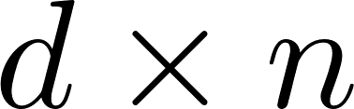

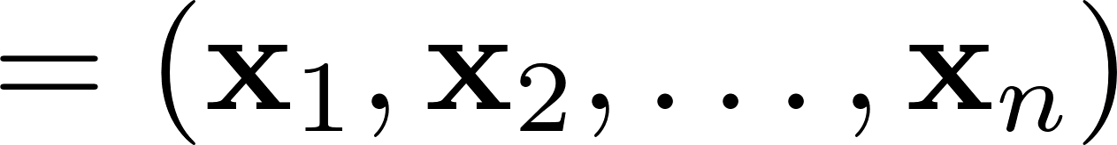
Notes:
Starting with a data matrix X of size [d by n]. it includes x_1, x_2 to x_n with d components.
x_i’s are iid random variables with mean zero and covariance matrix Sigma.
A data matrix is a very common data structure in many studies.

Slide 4

Notes:
An question is how to estimate Sigma

Slide 5
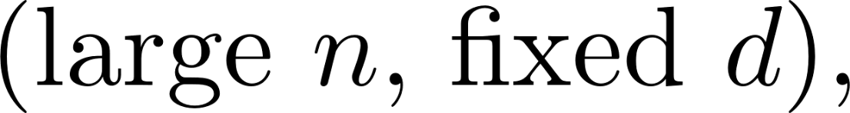



Notes:
In a classical case, that is , fixed d and large n,
We define the sample covariance matrix S, and then we have S is a consistent estimator of Sigma. More precisely, S is unbiased. We are happy.

Slide 6

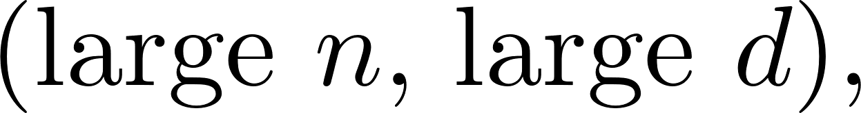
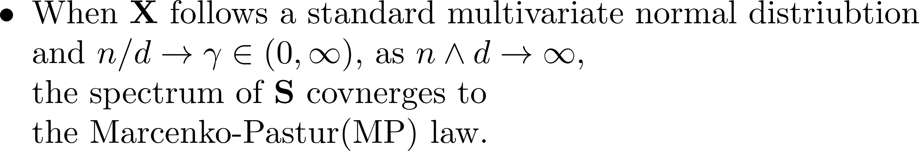
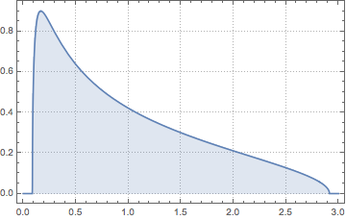
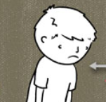


population eigenvalues
Notes:
However, in a big data, that is large d, large n. When x follows standard multivariate normal distribution in a random matrix setting, the spectrum of S converges to the MP law. All population eigenvalues are one but the estimators are not. It means that S is no longer a consistent. That is too bad.

Slide 7
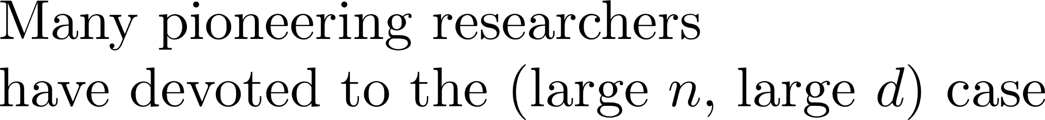






2001
Now
2022
Notes:
Many pioneering researchers have devoted to the case: large d and large n

Slide 8









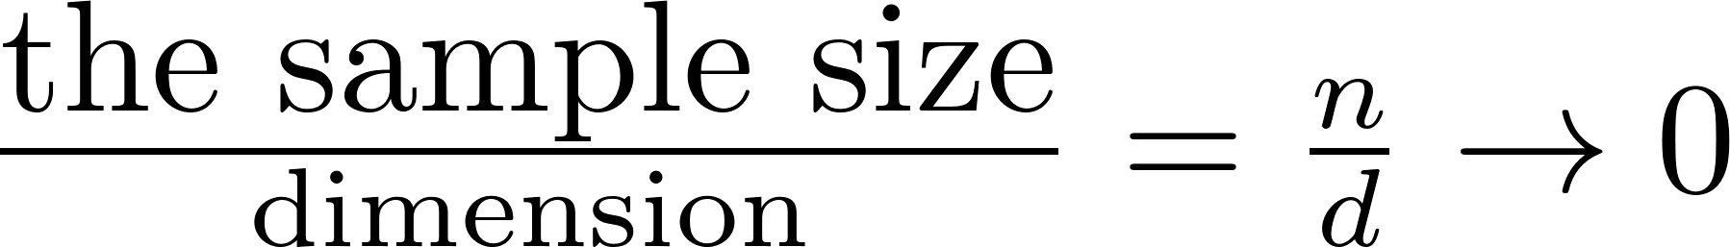
Notes:
HDLSS is a branch of this case. HDLSS means high dimension low sample size.
That is, the ratio of the sample size to dimension is low when n and d are large

Slide 9

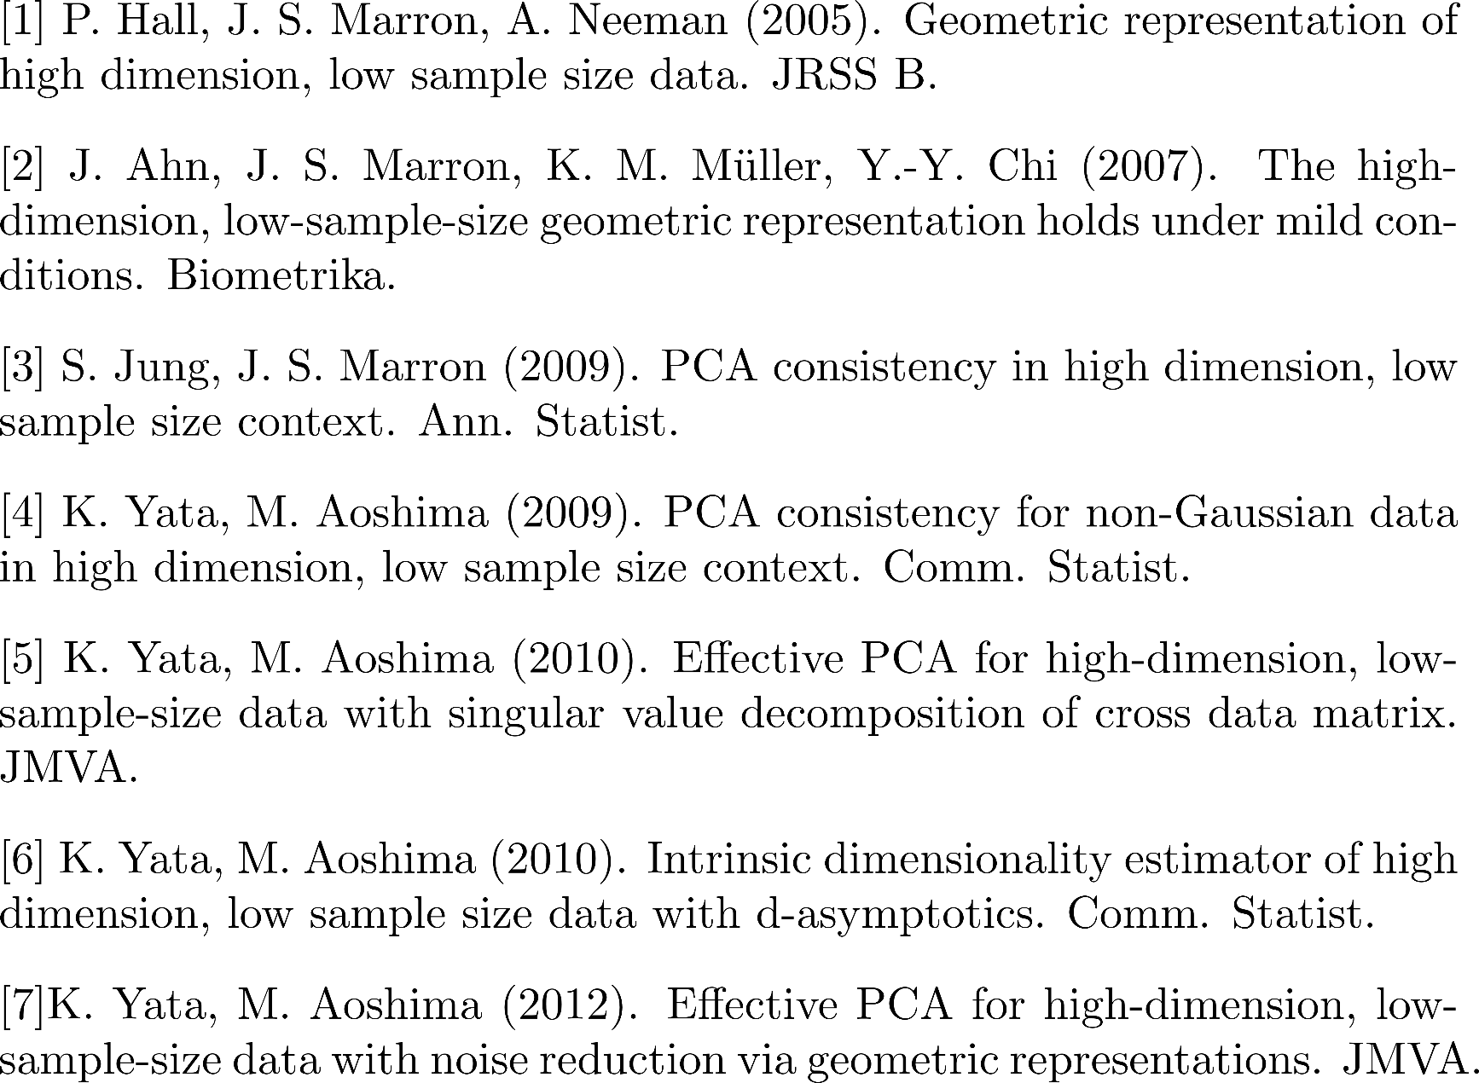
Notes:
For the HDLSS literature, Substantial works have been done.

Slide 10
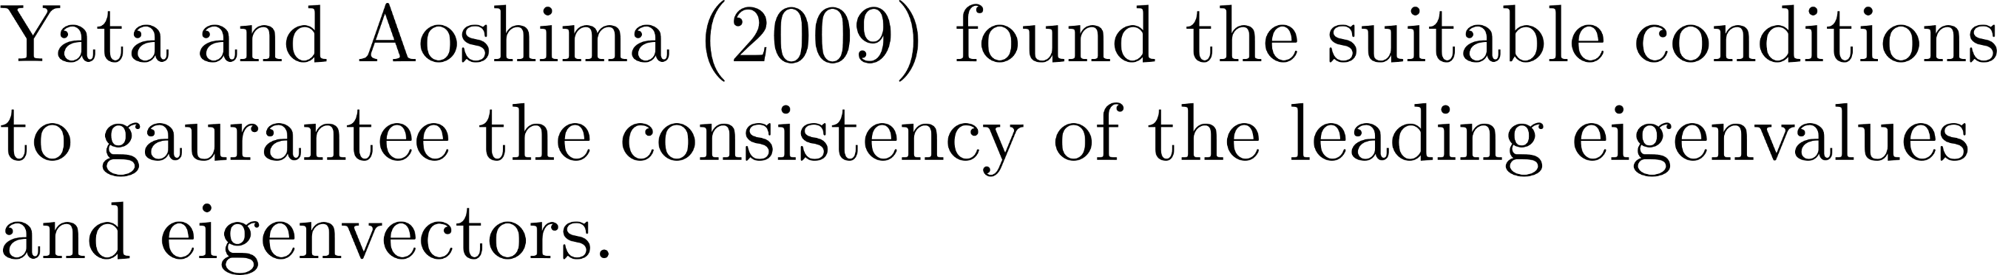
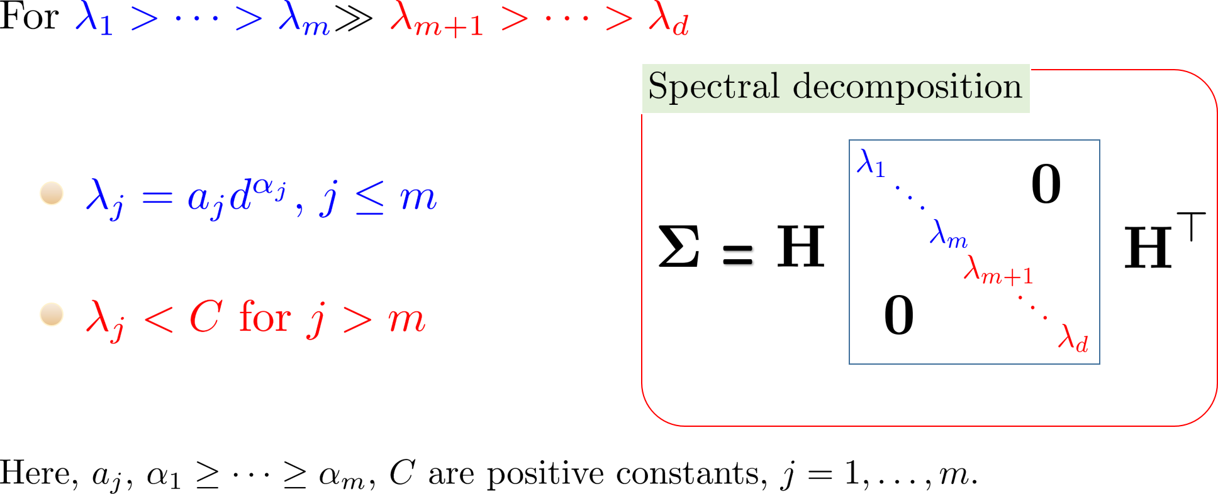
Spiked Covariance model
Notes:
Yata and Aoshima in 2009 found that … (repeat the slide)
We divide the population eigenvalues into two parts: leading and tail. For a leading part, the eigenvalue is a power function of d; for a tail part,
The eigenvalue is bounded.

Slide 11

Notes:
Yata and ashoma in 2010… (repeat slide) abbreviated as CDM-PCA

Slide 12


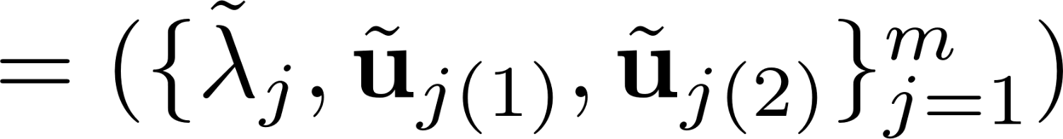

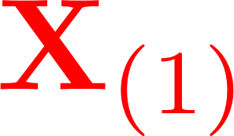
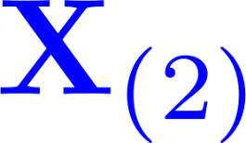
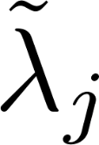
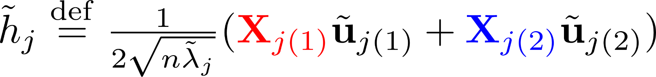
CDM-PCA eigenvalues
CDM-PCA eigenvectors
Notes:
CDM-PCA method means that
Assume the sample size is 2n
Divide the data matrix into two parts x_1 to x_n and x_{n+1} to x_{2n}, called
X1 and X2.
We calculate the cross product of X1 and X2
By the singular value decomposition, we have tilde lambda , tilde u1 tilde u2.
So we can have CDM-PCA eigenvalues and eigenvectors.

Slide 13

Notes:
Yata and Aoshima (repeat slide)

Slide 14
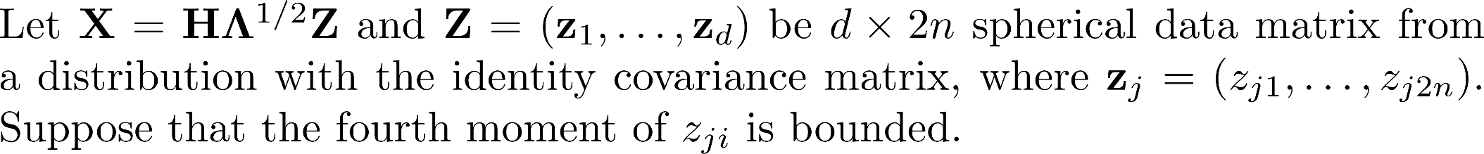


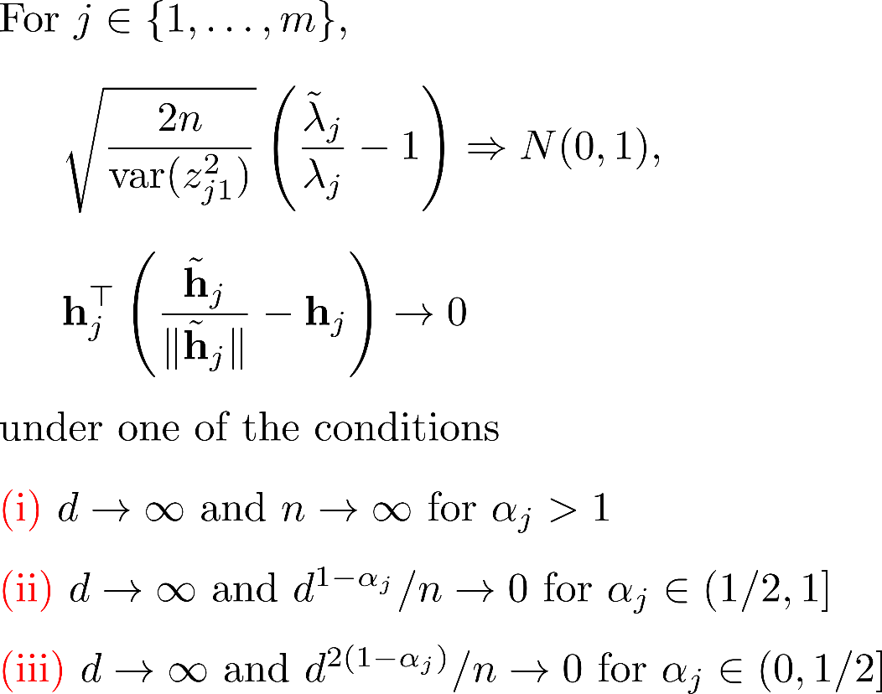
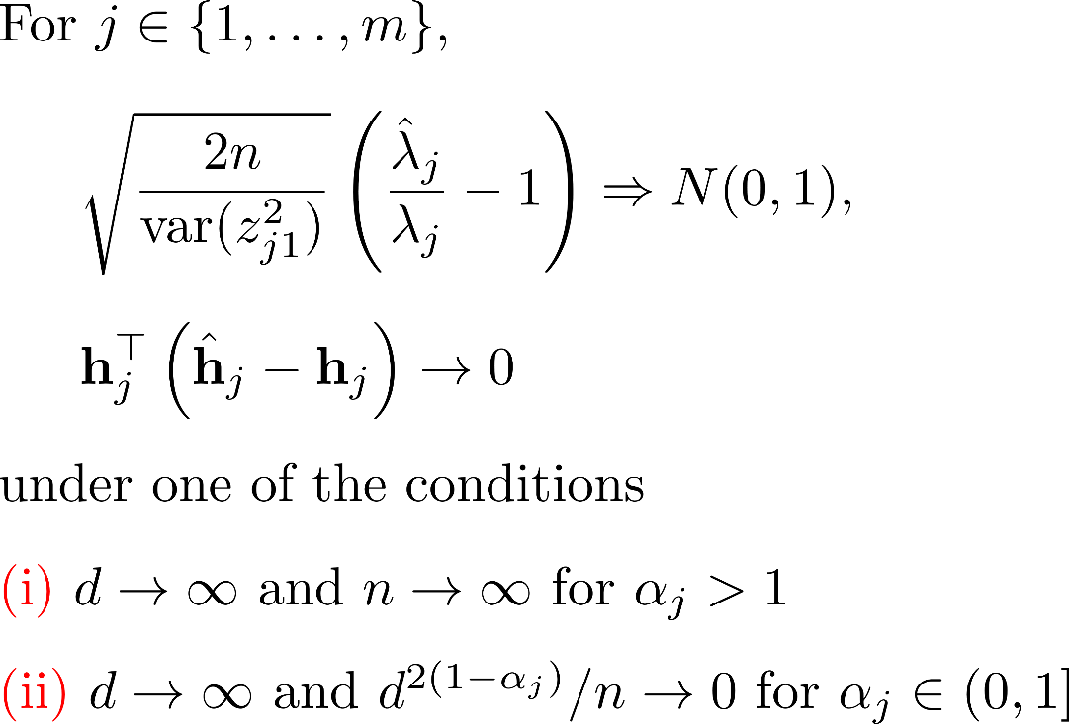
Notes:
CDM-PCA has broader consistency region to achieve the same
Asymptotic result as PCA.

Slide 15
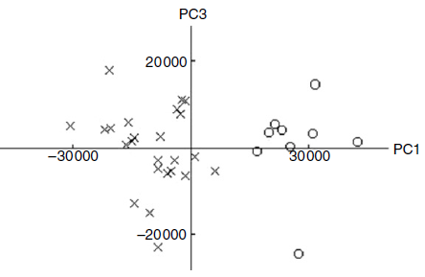
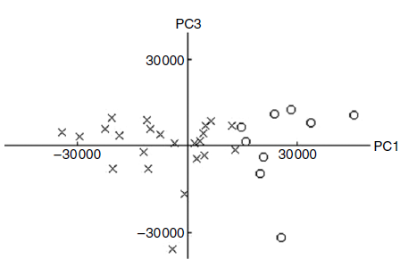
Notes:
CDM-PCA can be visualized effectively, In real data, the two clusters of CDM-PCA look like more separable than PCA

Slide 16
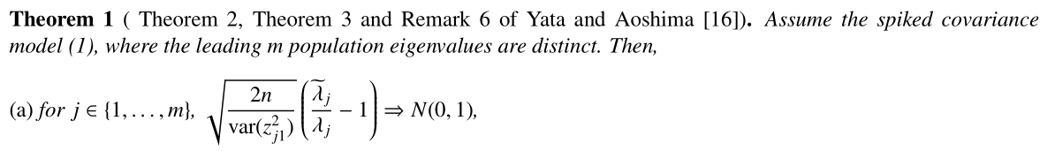
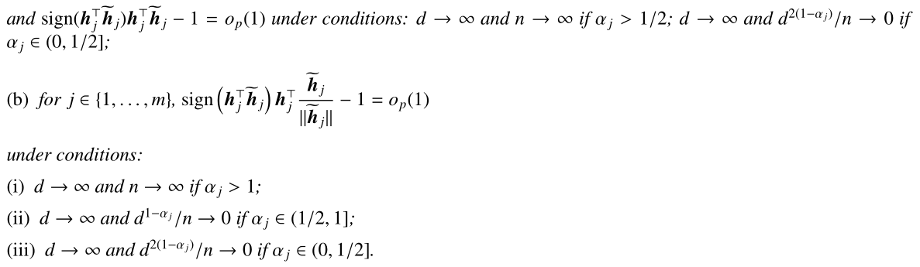
Theory for CDM-PCA

Slide 17
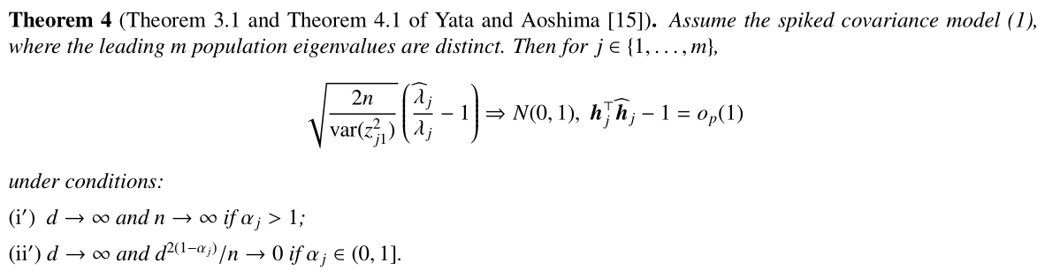
Theory for PCA

Slide 18
In Yata and Aoshima’s work
the asymptotic normality for PCA directions is lacking
the asymptotic normality for CDM-PCA directions is lacking
Notes:
Yata and Aoshima (repeat slide)

Slide 19
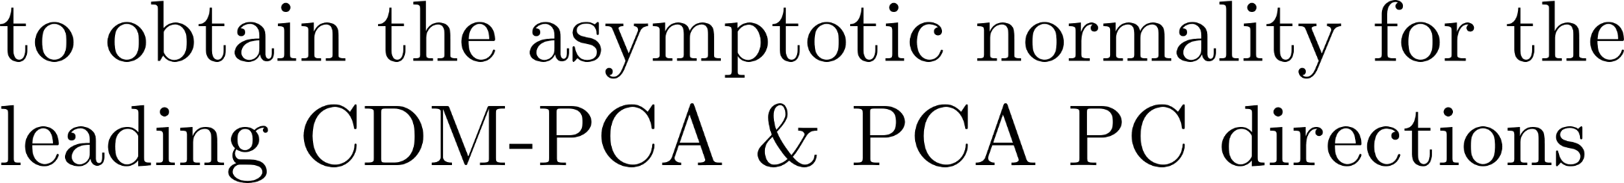

In 2020
Wang, Huang, and Chen have extend their work
1
2
Notes:
Yata and Aoshima (repeat slide)

Slide 20
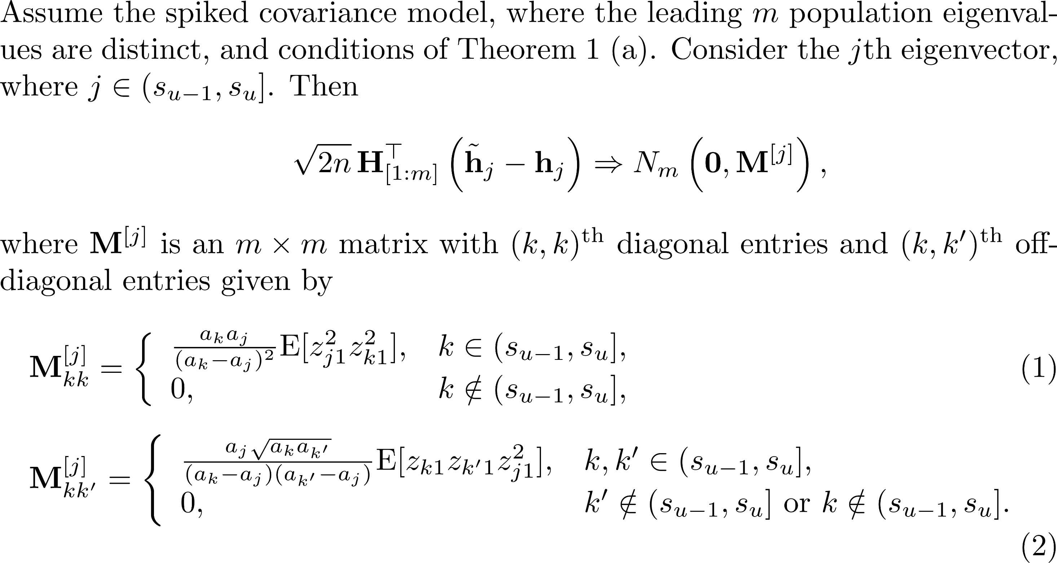
Theorem (CDM-PCA). (W., Huang and Chen, 2020 JMVA)
Notes:
I just show you our theoretical results. We use the projection method.

Slide 21
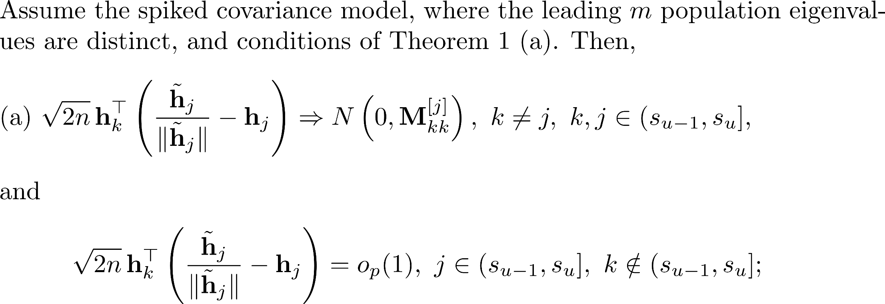

Slide 22
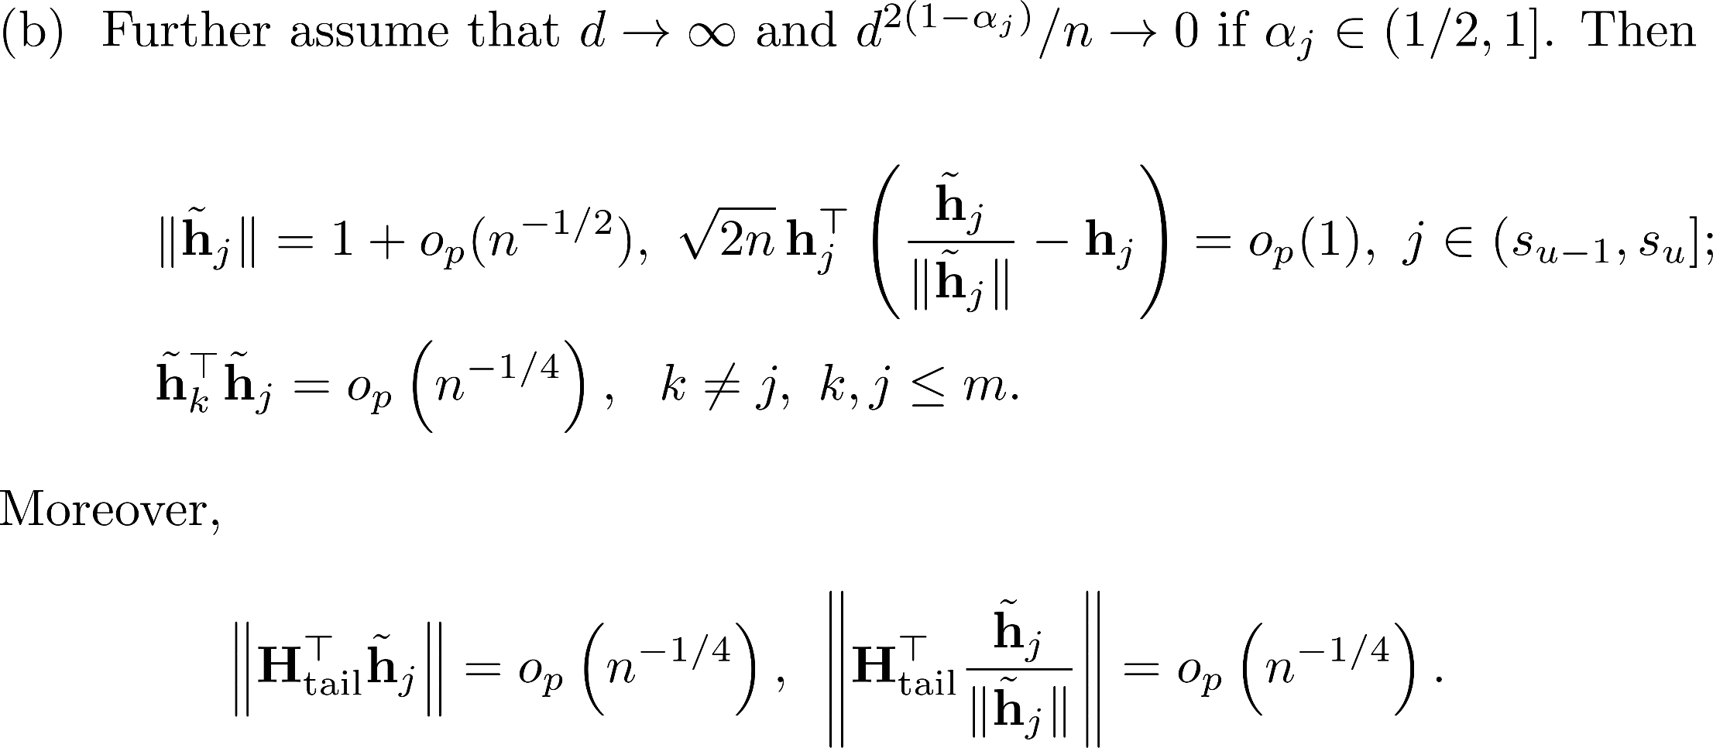

Slide 23
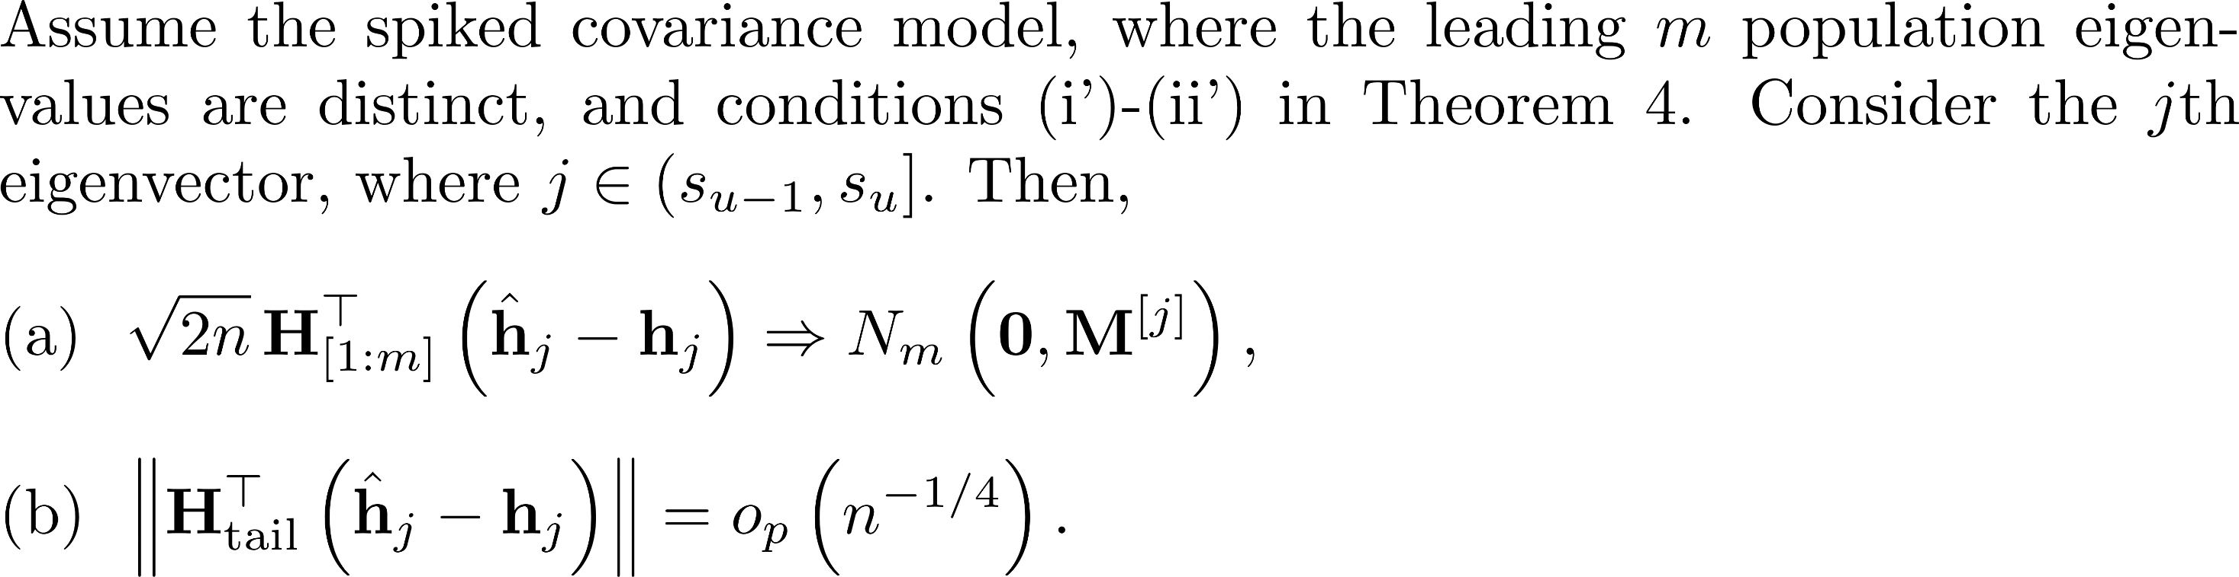
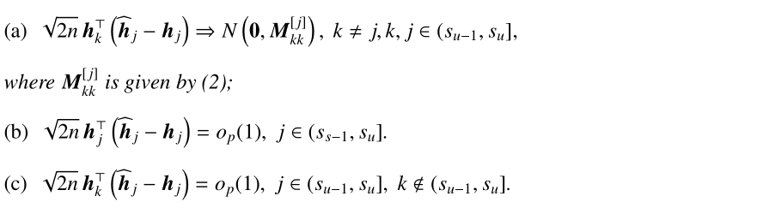

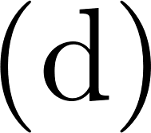
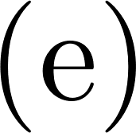
Theorem (PCA). (W., Huang and Chen, 2020 JMVA)

Slide 24
One day, Prof. Su-Yun asked me:
Although the difference in regions of consistency is well studied, an interesting practical as well as theoretical question is
how PCA and CDM-PCA PC directions differ in eigenvalues and
eigenvectors estimation, especially for the case where both
fall in a common region of consistency.
Notes:
Yata and Aoshima (repeat slide)

Slide 25
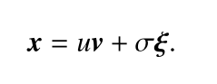
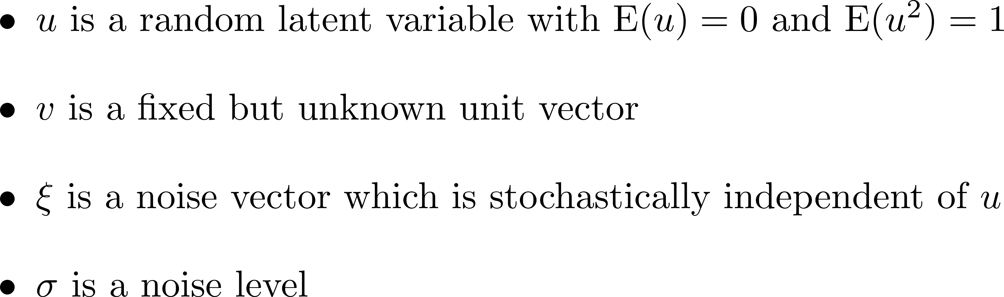
For simplicity,
we consider the case of a single component:
Notes:
Yata and Aoshima (repeat slide)

Slide 26
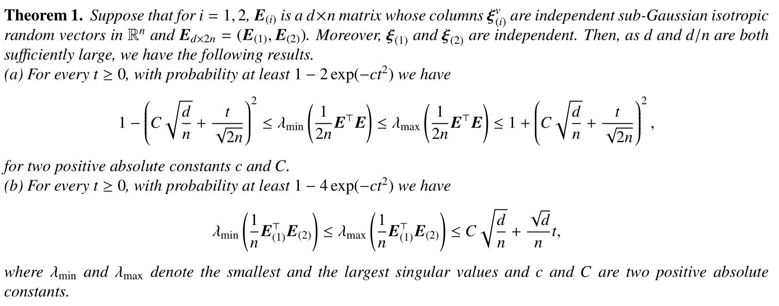
The effect of noise terms

Slide 27
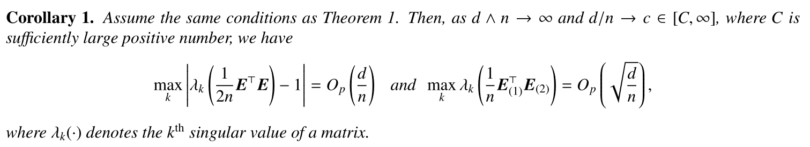
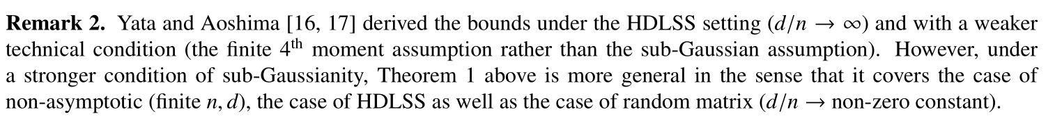

Slide 28
Perturbation theory for sample covariance
We apply the similar approach of Nadler (2008)
B. Nadler, Finite sample approximation results for principal component analysis: A matrix perturbation approach, The Annals of Statistics 36 (2008) 2791–817.
Notes:
Our contribution.

Slide 29
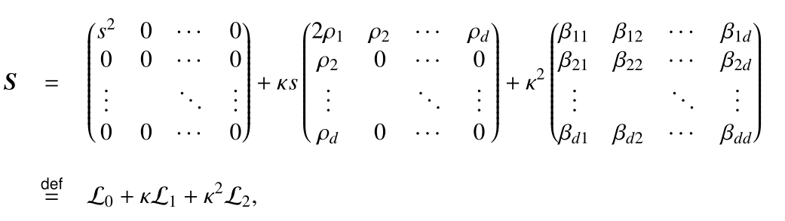
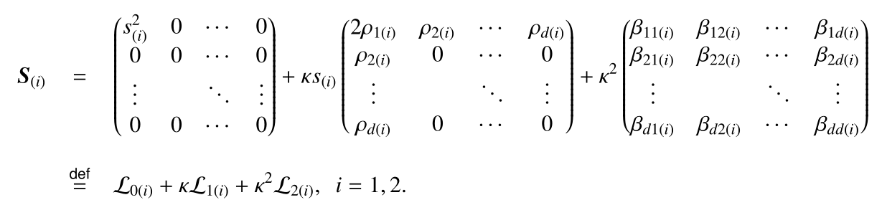
Notes:
Our contribution.

Slide 30
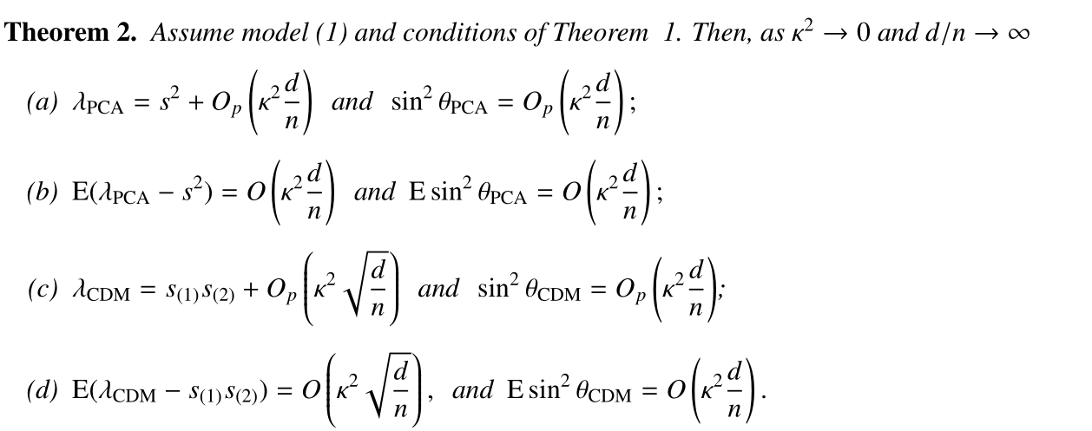

Slide 31
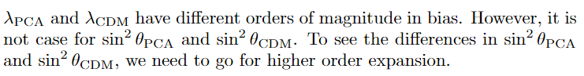
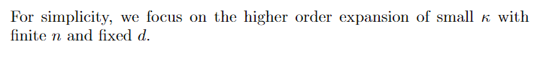

Slide 32
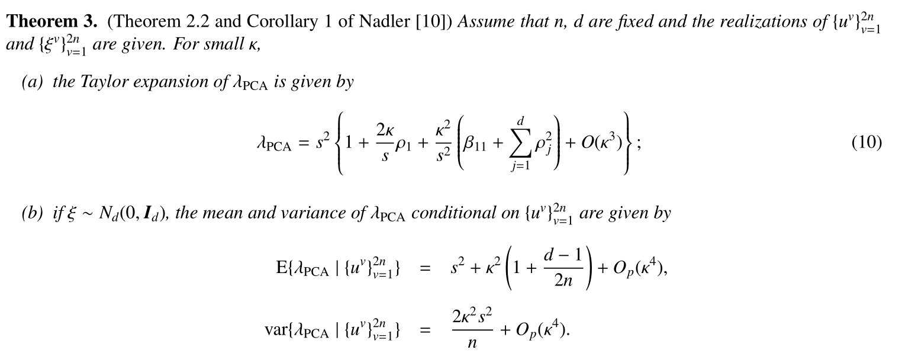

Slide 33
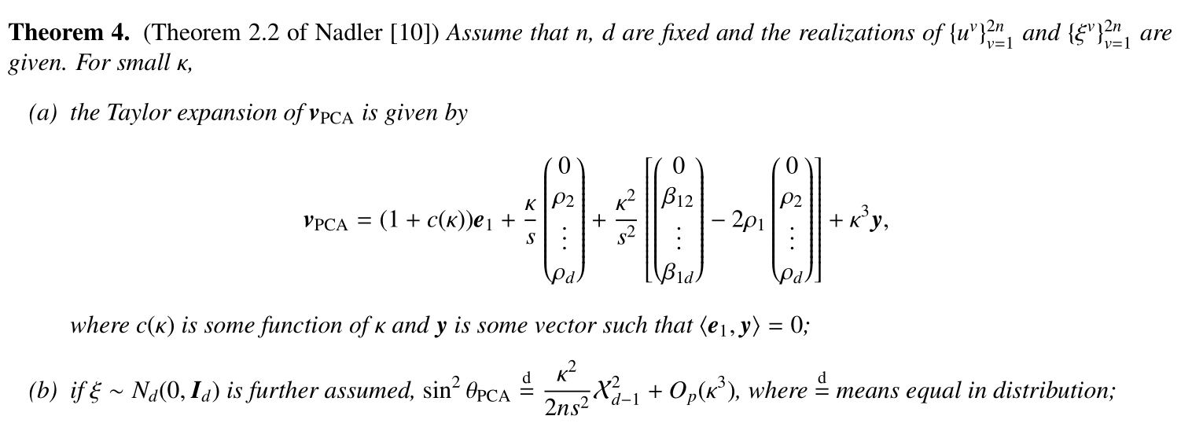

Slide 34
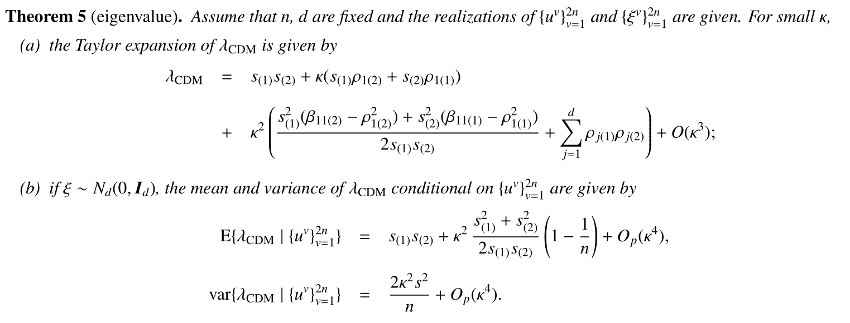

Slide 35
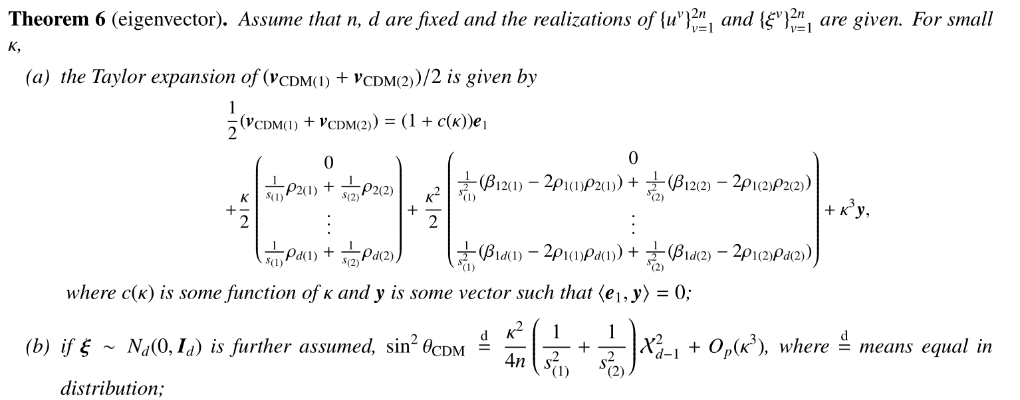

Slide 36
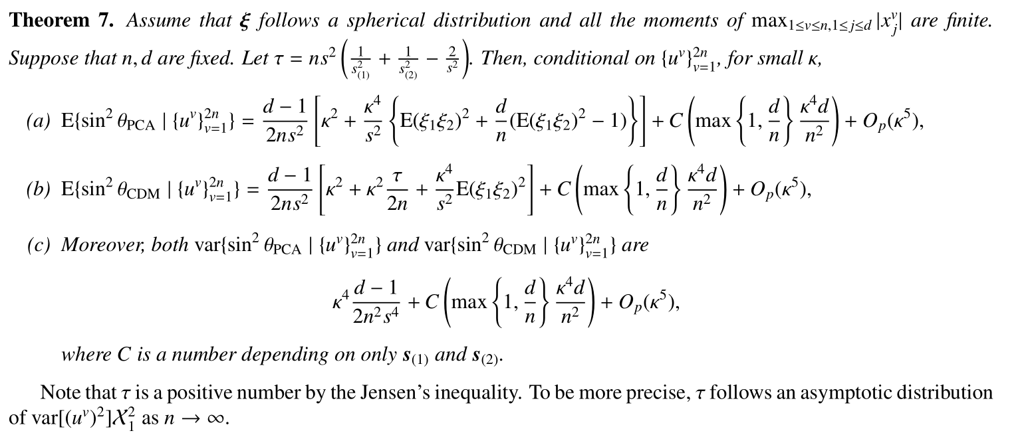

Slide 37
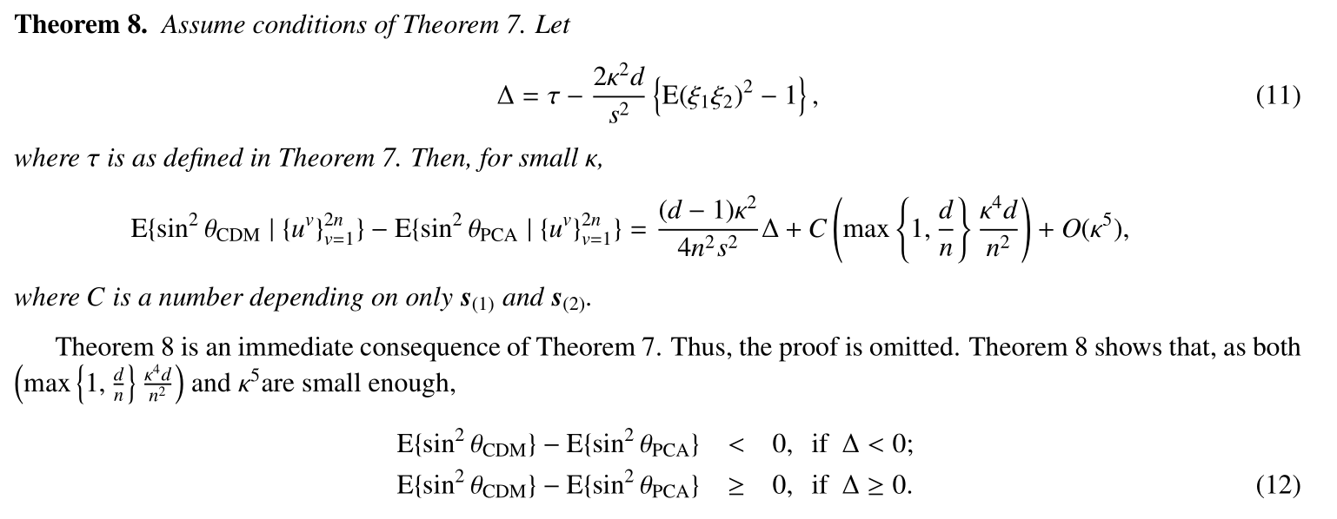

Slide 38
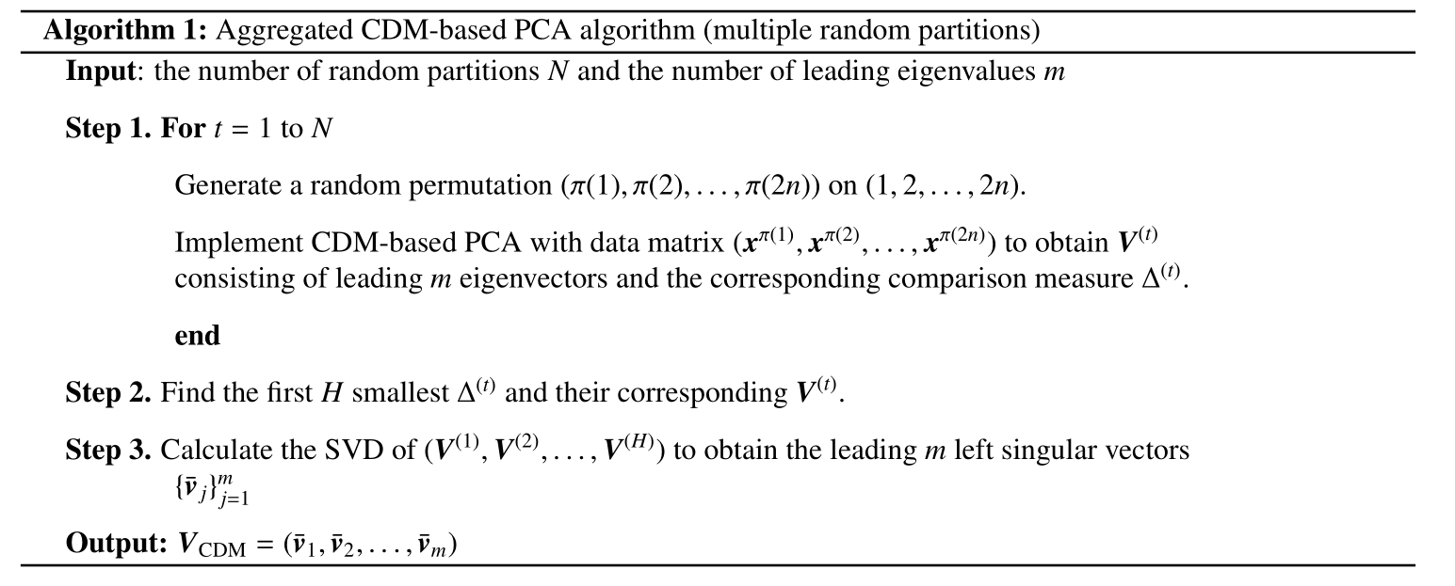

Slide 39


Slide 40


Slide 41


Slide 42

Example 1: Parkinson’s disease (PD) data

Slide 43

Example 2: Lung cancer data

Slide 44
Thanks for your attention
Notes:
My talk is in the end. Thanks for your attention.

